Slide 1
Unreal conditional
With if clauses

Slide 2
Unreal conditional 1
Often called the "unreal" conditional because it is used for unreal impossible or improbable situations. This conditional provides an imaginary result for a given situation. It is very unlikely that the condition will be fulfilled.
Form:
if + Simple Past, + would + base verb
Were / Was
In conditional type 1, we usually use were" instead of "was" in the if clause " even if the pronoun is I, he, she or it. "were" here is a subjunctive form.
NOTE "was" is also a possible form.

Slide 3
Example:
If I were a millionaire, I would buy a castle.
Use
Unreal Conditional Sentences Type 1 refers to an action in the present that could happen if the present situation were different. I don't really expect the situation to change because it is very unlikely.
If I had a lot of money, I would travel around the world.

Slide 4
Unreal conditional 2
It is impossible that the condition will be met because it refers to the past.
Form:
if + Past Perfect, + would + have + Past Participle
Use
Conditional Sentences Type 3 refer to situations in the past. They express hypothetical results to past given situations.

Slide 5
Example:
If he had been careful, he wouldn't have had that terrible accident.
Sometimes in the past, he was careless. He drove so fast. So he had a terrible accident
Things To Remember
The main clause can be also at the beginning of the sentence. In this case, don't use a comma.
Examples:
"Phosphorus burns if you expose it to air."
" I will send her an invitation if I find her address."
" I would travel around the world if I had a million dollars."
"He wouldn't have had that terrible accident if he had been careful."

Slide 6
Main clause and/or if clause might be negative.
Example:
If I don’t see him this afternoon, I will phone him in the evening.
If he had been careful, he wouldn't have had an accident.
REFERENCE – Past Unreal and Mixed Conditionals
 | If clause | Result clause
Past Unreal | If I had studied, Past perfect | I would have passed the test Perfect conditional Would have + past participle
Mixed Conditional | If I had studied harder at school, Past perfect | I would have a better job now. Would + simple present

Slide 7
Modals: Past Tense
Can, Could, Will, Would, Should

Slide 8
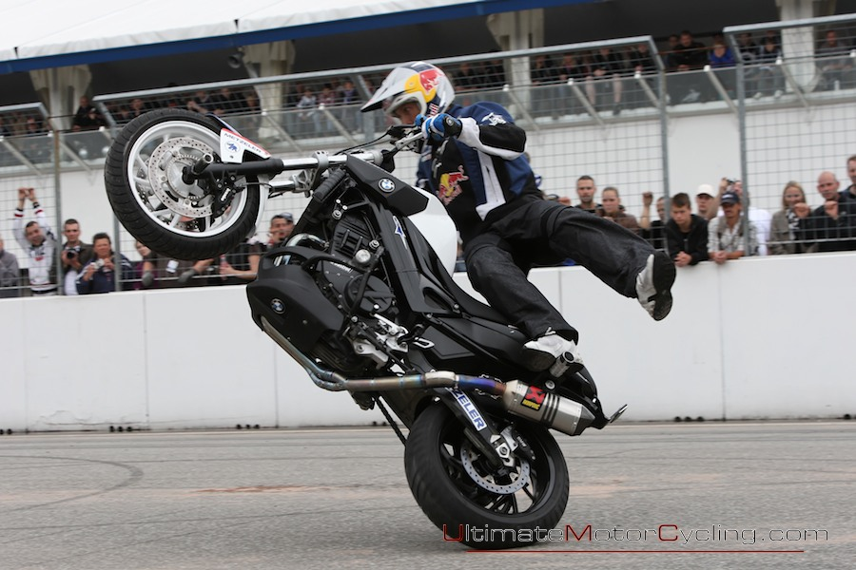
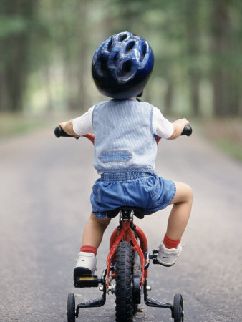
The Past Tense of Can = Could
I can ride a motorcycle.
I could ride a bike
(when I was young).

Slide 9
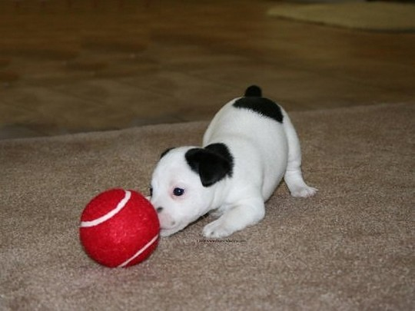
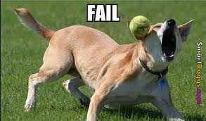
The Past Tense of Can’t = Couldn’t
The dog can’t catch the ball.
The dog couldn’t catch the ball when he was a puppy.

Slide 10

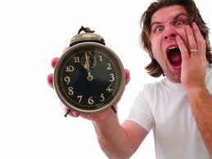
The Past Tense of Will = Would
He says he will be on time.
He said he would be on time
(but he was late).

Slide 11
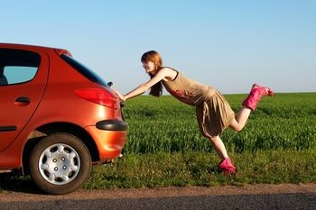
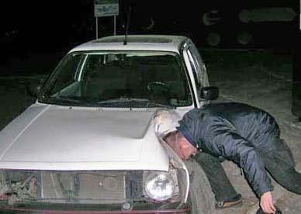
The Past Tense of Won’t = Wouldn’t
Her car won’t start.
His car wouldn’t start last night.

Slide 12
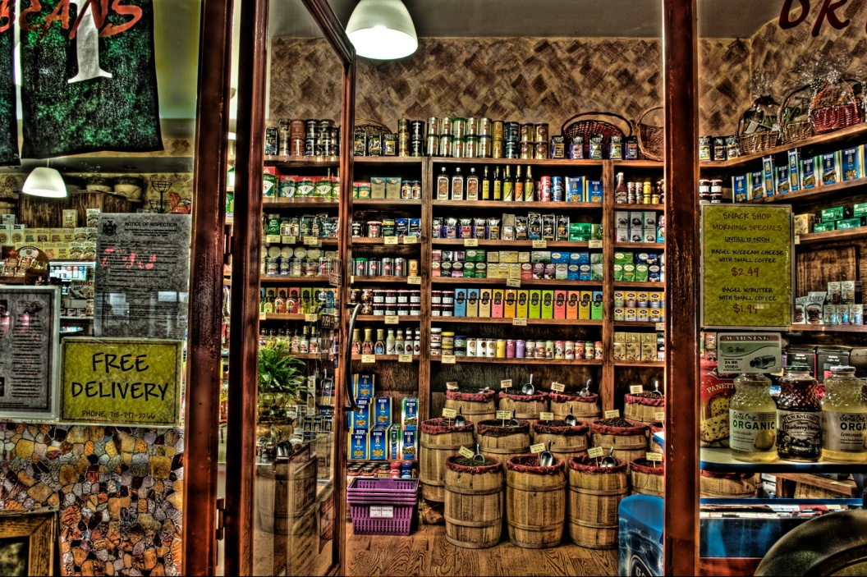
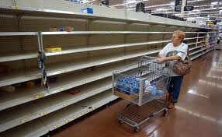
The Past Tense of Could = Could + Have + Past Participle
We could buy some snacks before the game starts.
We could have bought some snacks, but now there aren’t any.

Slide 13
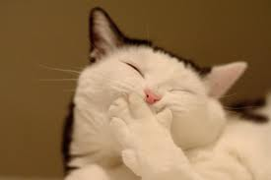
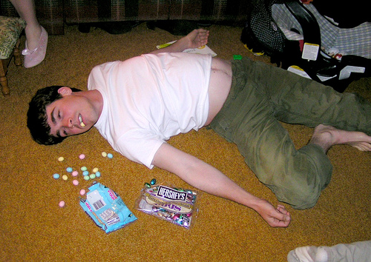
The Past Tense of Couldn’t = Couldn’t + Have + Past Participle
He couldn’t have eaten so much candy without getting sick!
The cat couldn’t possibly eat more now.

Slide 14
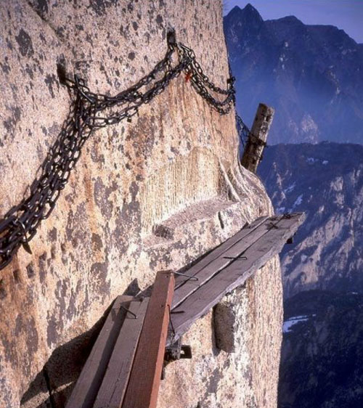
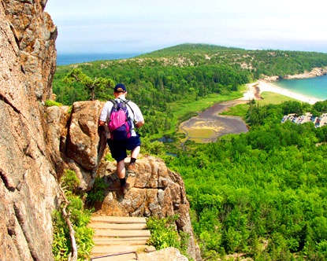
The Past Tense of Would = Would + Have + Past Participle
He would like to go hiking if he gets time off work.
He would have liked the hike if he hadn’t been so scared.

Slide 15
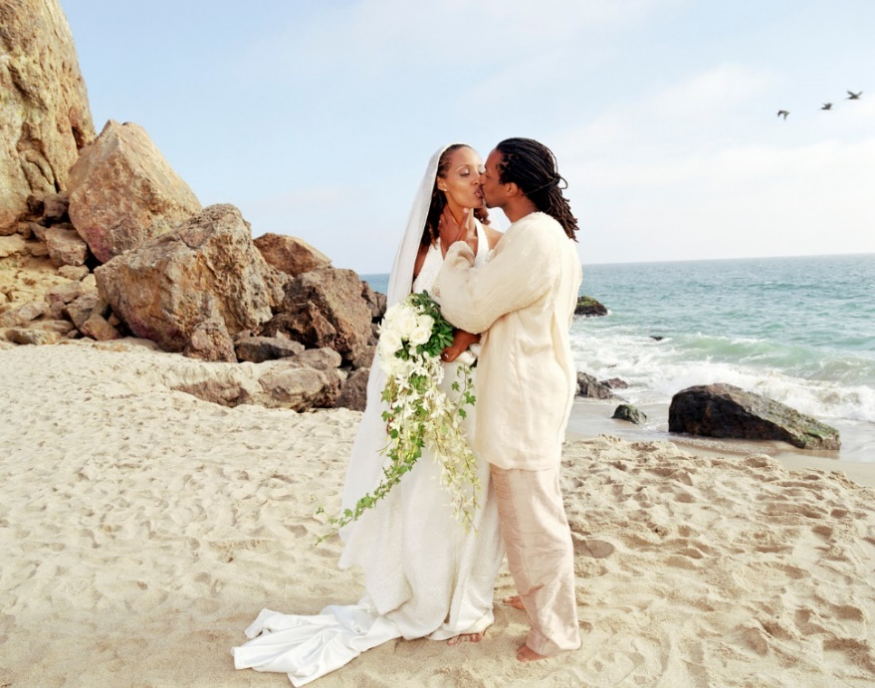
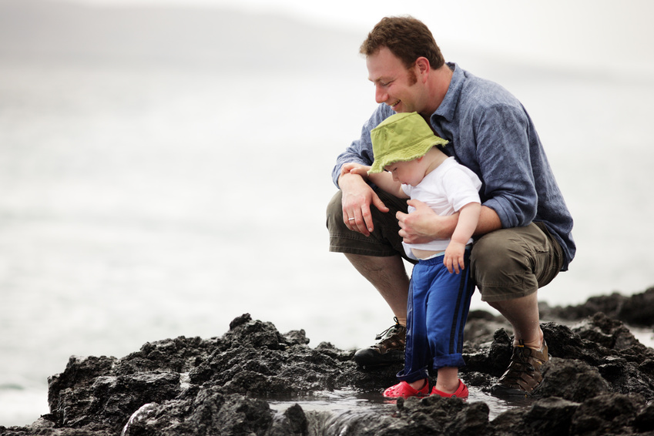
The Past Tense of Wouldn’t = Wouldn’t + Have + Past Participle
He wouldn’t go to the beach without his dad, because he can’t swim.
They wouldn’t have gone to the beach after the wedding if they didn’t like the sand.

Slide 16
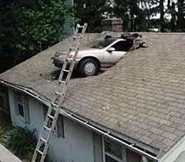

The Past Tense of Should = Should + Have + Past Participle
You should obey the traffic rules.
You should have obeyed the traffic rules.

Slide 17
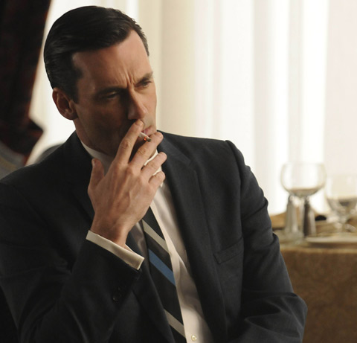
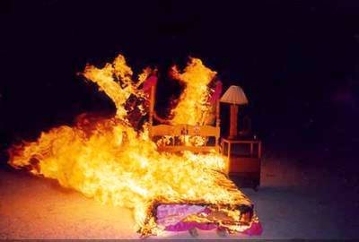
The Past Tense of Shouldn’t = Shouldn’t + Have + Past Participle
He shouldn’t smoke.
He shouldn’t have smoked in bed (because it caught on fire).

Slide 18
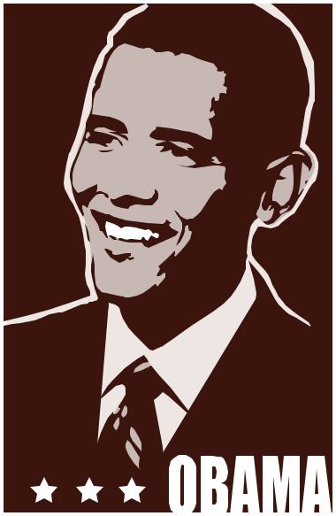

The Past Tense of Must =
Must + Have + Past Participle
It must have been hard for George Bush to be president. He was very unpopular.
Barack Obama looks stressed. It must be hard to be president.

Slide 19
Let’s Practice!
Fill in the blank with the past tense modal
I can ride a horse, and when I was young,
I _____ride a pony. (ability in the past)

Slide 20
Let’s Practice!
Fill in the blank with the past tense modal
I can ride a horse, and when I was young,
I could ride a pony. (ability in the past)

Slide 21
Let’s Practice!
Fill in the blank with the past tense modal
I can’t catch a ball.
I _______ catch a ball, even when I was on a baseball team. (ability in the past)

Slide 22
Let’s Practice!
Fill in the blank with the past tense modal
I can’t catch a ball.
I couldn’t catch a ball, even when I was on a baseball team. (ability in the past)

Slide 23
Let’s Practice!
Fill in the blank with the past tense modal
I’m having so much fun, I could stay up all night! (possibility)
I was having so much fun last night, I _______________ all night! (possibility in the past)

Slide 24
Let’s Practice!
Fill in the blank with the past tense modal
I’m having so much fun, I could stay up all night!
I was having so much fun last night, I
could have stayed up all night!
(possibility in the past)

Slide 25
Let’s Practice!
Fill in the blank with the past tense modal
They would buy a new car if they had enough money. (conditional)
They _______________ a new car, but they didn’t save enough money. (conditional in the past)

Slide 26
Let’s Practice!
Fill in the blank with the past tense modal
They would buy a new car if they had enough money.
They would have bought a new car, but they didn’t save enough money. (conditional in the past)

Slide 27
Let’s Practice!
Fill in the blank with the past tense modal
He wouldn’t leave his wife, even if he won the lottery today. (conditional)
He ___________________ his wife, even if he had won the lottery last week. (conditional in the past)

Slide 28
Let’s Practice!
Fill in the blank with the past tense modal
He wouldn’t leave his wife, even if he won the lottery today.
He wouldn’t have left his wife, even if he had won the lottery last week. (conditional in the past)

Slide 29
Let’s Practice!
Fill in the blank with the past tense modal
We should go on vacation, before it’s too late.
(advise)
We ______________ on vacation, but now it’s too late. (regret about the past)

Slide 30
Let’s Practice!
Fill in the blank with the past tense modal
We should go on vacation, before it’s too late.
(advice)
We should have gone on vacation, but now it’s too late. (regret about the past)

Slide 31
Let’s Practice!
Fill in the blank with the past tense modal
You shouldn’t break the company’s rules.
(advise)
You ___________________ the company’s rules – now you don’t have a job. (regret about the past, criticism)

Slide 32
Let’s Practice!
Fill in the blank with the past tense modal
You shouldn’t break the company’s rules.
You shouldn’t have broken the company’s rules – now you don’t have a job. (regret about the past, criticism)

Slide 33
Let’s Practice!
Fill in the blank with the past tense modal
They look happy. Their team must be winning now. (logical conclusion)
The game is over and they are cheering. Their team ___________________.
(logical conclusion or 100% certainty)

Slide 34
Let’s Practice!
Fill in the blank with the past tense modal
They look happy. Their team must be winning now. (logical conclusion)
The game is over and they are cheering. Their team must have won. (logical conclusion or 100% certainty)

Slide 35
Questions?
Would you like to ask a question?
Could I help answer any questions?

